Slide 1
Data Science For Chemoinformatics
BIOINF 595
Matthew O’Meara
2/4/2025

Slide 2
House Keeping
Where we are in the course
Goal was to give “authentic” research experience => throw into the deep end
Switching over to data science / chemoinformatics / ML
Welcome feedback
We’ve created a slack group
Office hours by appointment
Recommend working together to build community and collaborative learning
Michigan Molecular Modeling super-group meeting
Friday 3-4pm in Palmer 2036

Slide 3
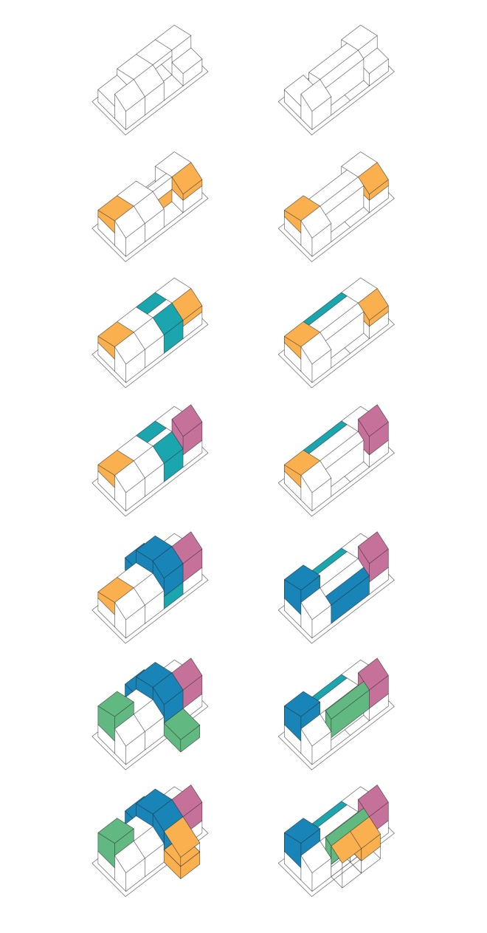
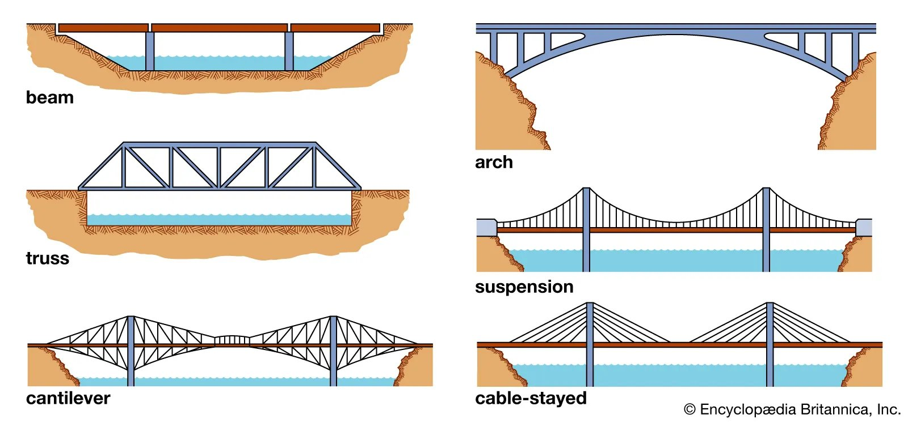




Data science is a design problem
Notes:
Tatina Bilbao

Slide 4

Principles of Software Design Abstraction
Notes:
On Representational Abstraction
https://www.cs.utexas.edu/~EWD/ewd03xx/EWD393.PDF

Slide 5
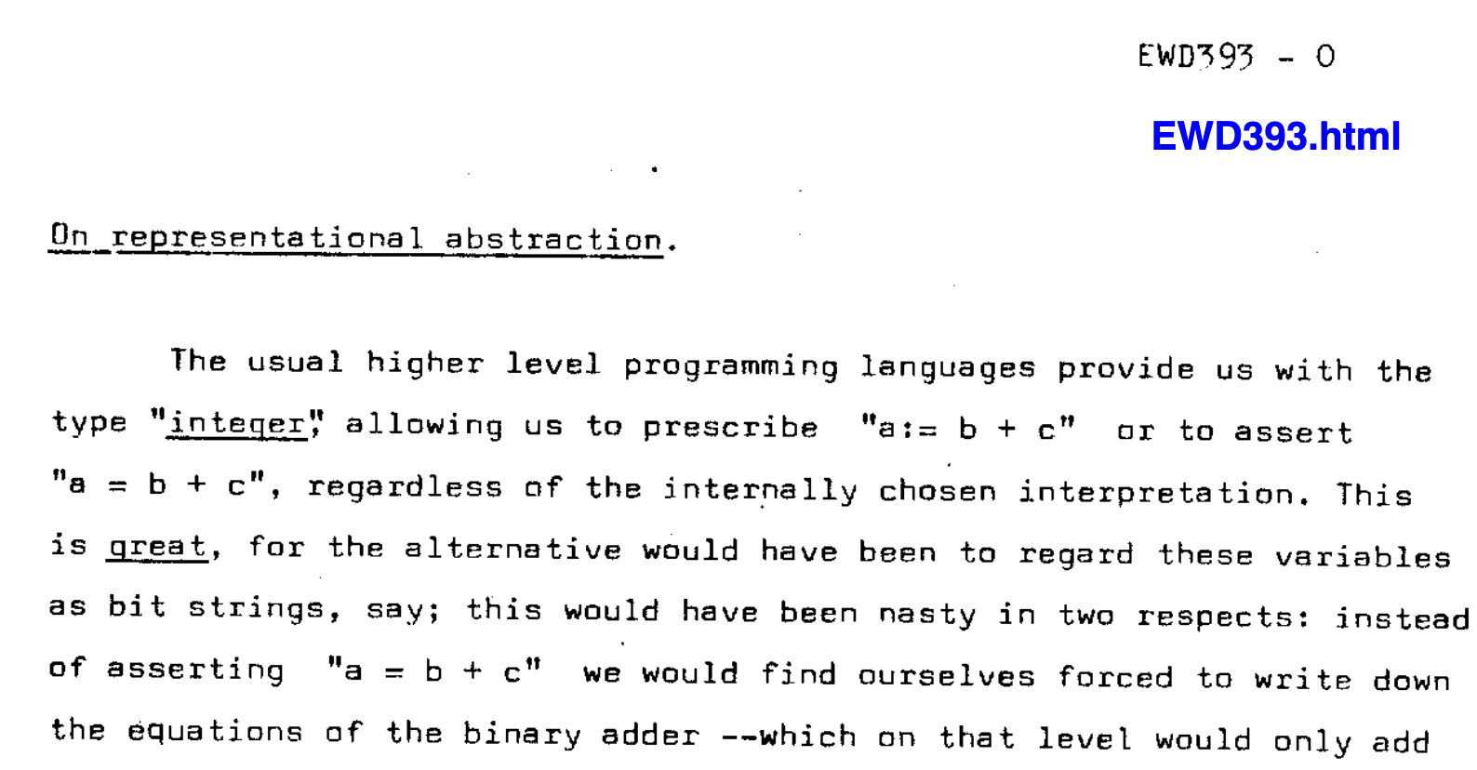
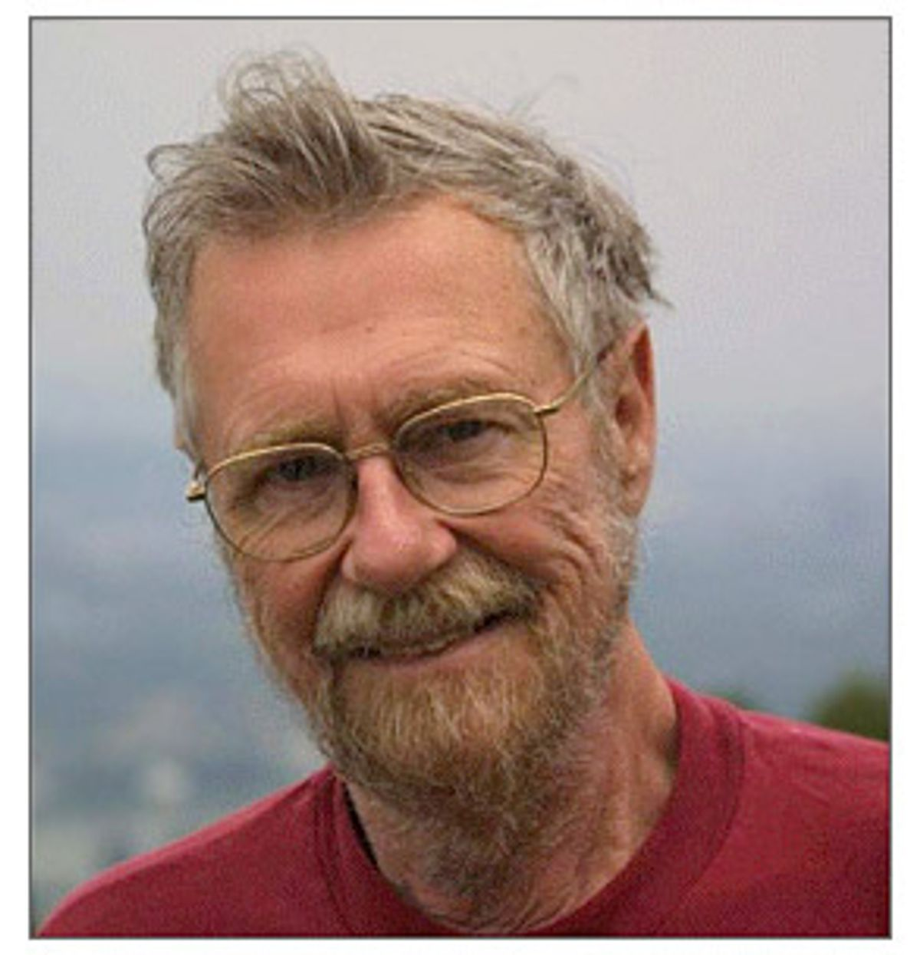
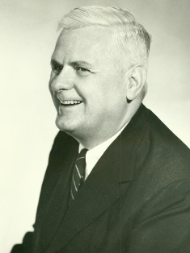
Function / Module / Package
Inputs
Output
Edward Dijkstra
1970s
Stochasticity
Internal
State
Side
effects
Alonzo Church
def sort(list):
….
class tensor:
….
import pytorch
….
Notes:
On Representational Abstraction
https://www.cs.utexas.edu/~EWD/ewd03xx/EWD393.PDF

Slide 6
Project Organization Structure
projects/
<project_name>/
parameters.yaml
README.md
data/
intermediate/
<stage_1_name>/
<stage_2_name>/
product/
src/
01_<stage_1_name>.{py,R,sh}
02.1_<stage_2_name>.{py,R,sh}
02.2_<stage_2_name>.{py,R,sh}
<helper_script>.{py,R,sh}

Slide 7
Project Organization Structure
projects/
<project_name>/
parameters.yaml
README.md
data/
intermediate/
<stage_1_name>/
<stage_2_name>/
product/
src/
01_<stage_1_name>.{py,R,sh}
02.1_<stage_2_name>.{py,R,sh}
02.2_<stage_2_name>.{py,R,sh}
<helper_script>.{py,R,sh}
Inputs from the outside world
=> Copy or symlink data here

Slide 8
Project Organization Structure
projects/
<project_name>/
parameters.yaml
README.md
data/
intermediate/
<stage_1_name>/
<stage_2_name>/
product/
src/
01_<stage_1_name>.{py,R,sh}
02.1_<stage_2_name>.{py,R,sh}
02.2_<stage_2_name>.{py,R,sh}
<helper_script>.{py,R,sh}
Temporary data that can be deleted and regenerated
Data and code

Slide 9
Project Organization Structure
projects/
<project_name>/
parameters.yaml
README.md
data/
intermediate/
<stage_1_name>/
<stage_2_name>/
product/
src/
01_<stage_1_name>.{py,R,sh}
02.1_<stage_2_name>.{py,R,sh}
02.2_<stage_2_name>.{py,R,sh}
<helper_script>.{py,R,sh}
Output analysis, plots, tables
Each file should be versioned

Slide 10
Project Organization Structure
projects/
<project_name>/
parameters.yaml
README.md
data/
intermediate/
<stage_1_name>/
<stage_2_name>/
product/
src/
01_<stage_1_name>.{py,R,sh}
02.1_<stage_2_name>.{py,R,sh}
02.2_<stage_2_name>.{py,R,sh}
<helper_script>.{py,R,sh}
Code to run analysis
Can numbered scripts in order
Use substages to group types of analysis
Un-numbered scripts are helper code

Slide 11
Recommendations
Containers
Singularity can work on HPC clusters
Good for reproducibility, but hard to re-use otherwise
Websites
Easy step to increase professionalism
Github websites are free and easy
maomlab.github.io/
Anti-Recommendations
Scientific workflow platforms
Make, Snakemake, Airflow, Prefect
=> Often more complicated and not-robust
Jupyter notebooks
Good for demos
Very difficult to version control

Slide 12
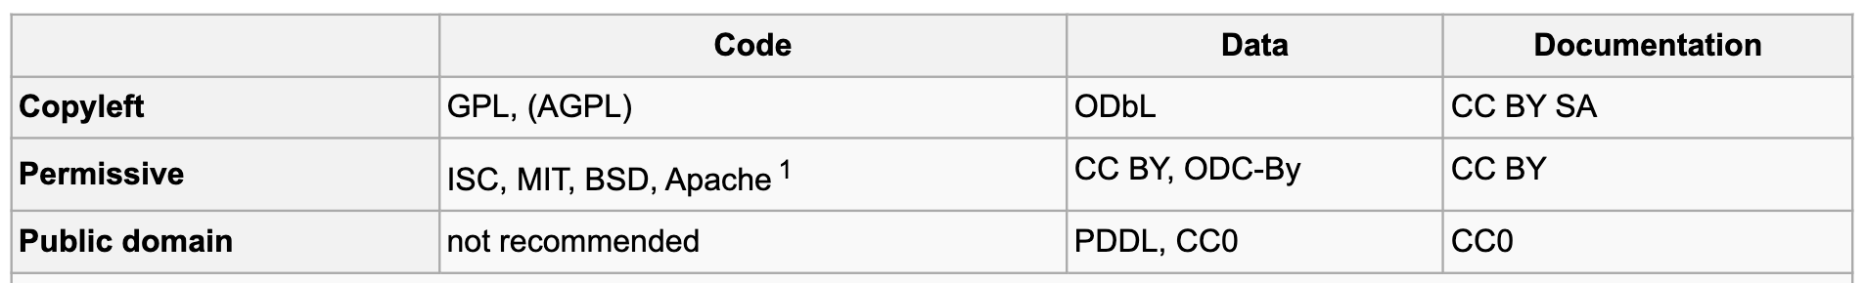

Principles of Software Design Interface
Testing / Vignettes / Documentation
Communicate with user about what usage is supported
If a user runs unsupported code => if it breaks, it’s the user’s fault
If a user runs supported code and it breaks => if it breaks, it’s the developers fault
Version Control
Learn the basics of git / github / gitlab etc.
Share tagged versions for reproducibility
Semantic versioning (https://semver.org/)
<MAJOR>.<MINOR>.<PATCH>
E.g. Python 3.13.1
MAJOR version when you make incompatible API changes
MINOR version when you add functionality in a backward compatible manner
PATCH version when you make backward compatible bug fixes
Date codes: YYYYMMDD
E.g. <analysis>_20250204.pdf
sorts alphabetically ☺
Licensing
Dialog between developers and users, if in doubt, ask!
Recommendations from
https://choosealicense.com/

Slide 13
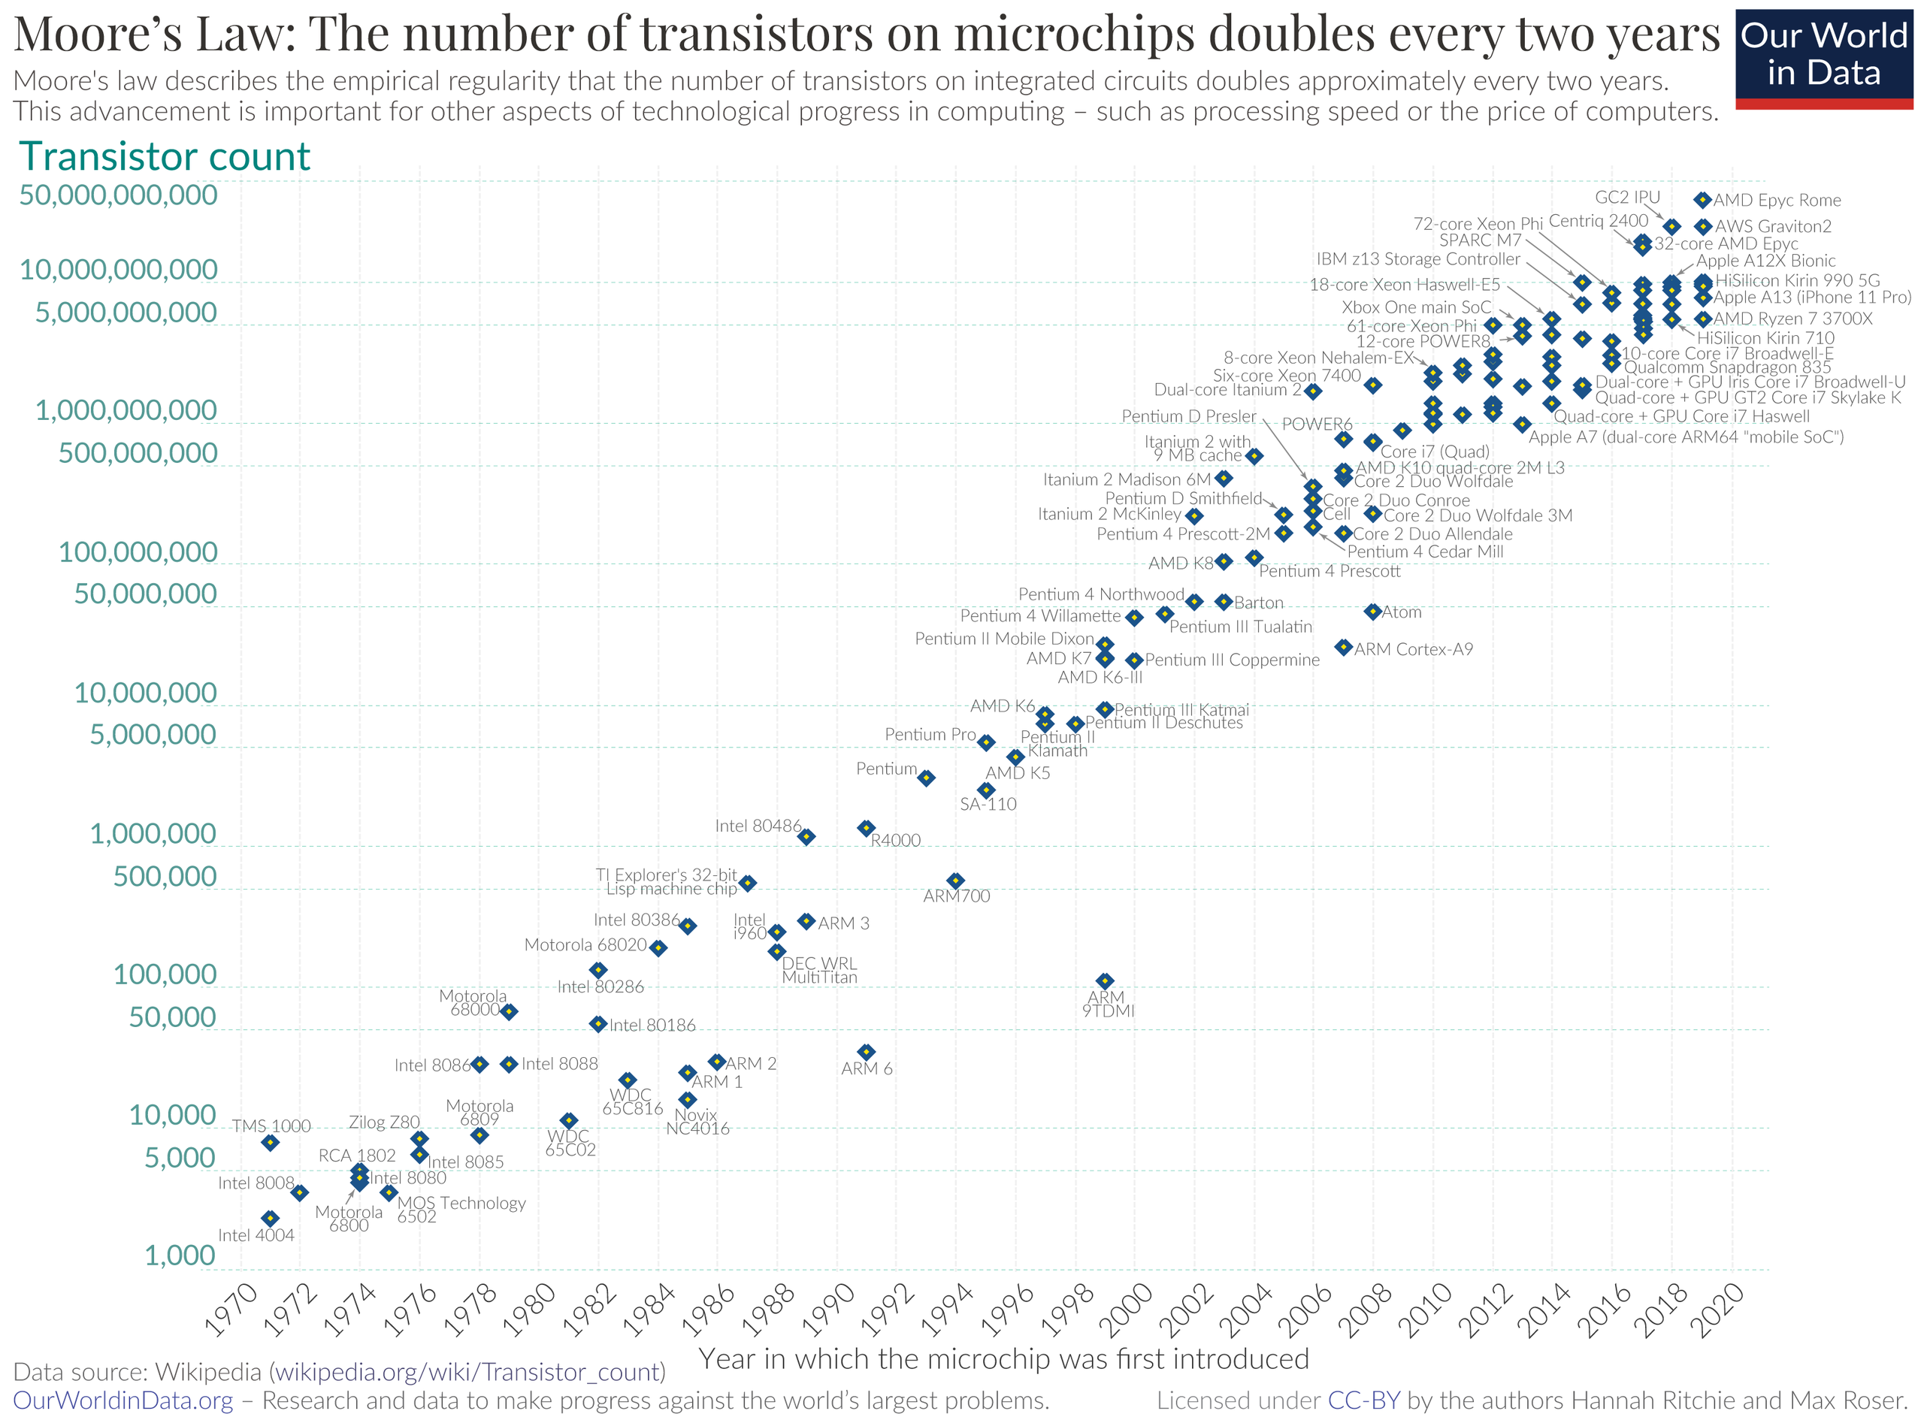
Moore’s law for CPUs
Principles of Software Design Cost
Driven by
markets

Slide 14
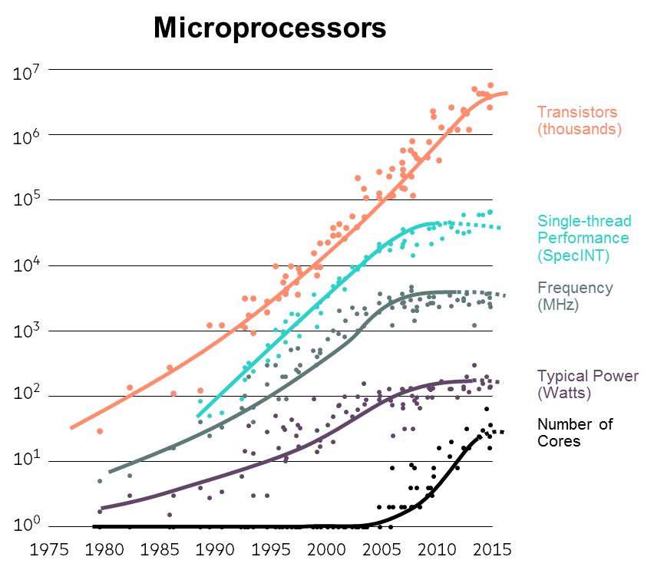
Moore’s law for CPUs
Driven by business cycle to sell chips
Moore’s law ended in 2005
Capped by heat-dissipation
Going forwards
costs will depend on
power consumption
not cost of
manufacturing chips
(Ibrahim, world economic forum, 2019)

Slide 15
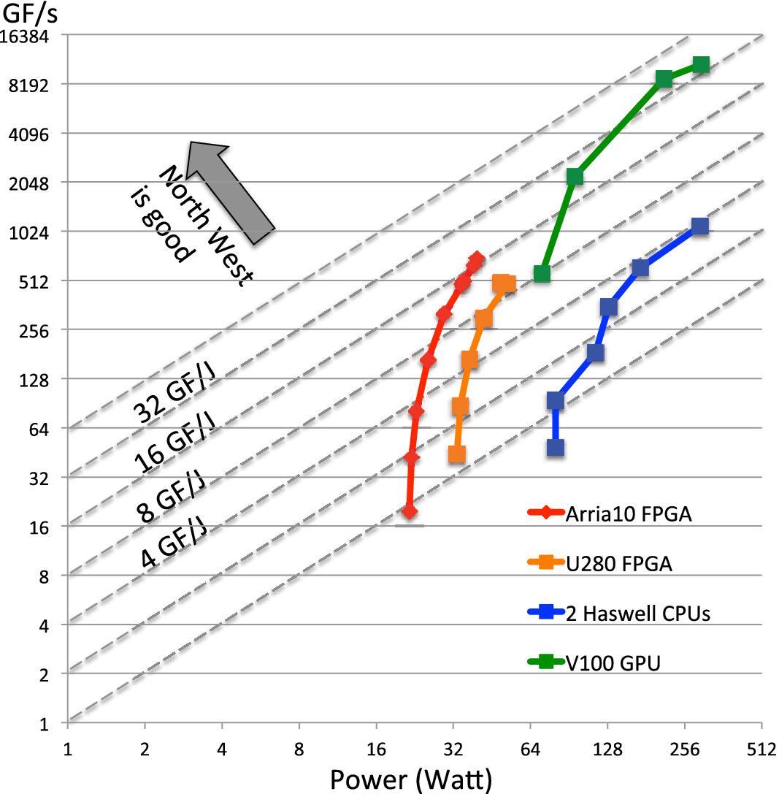
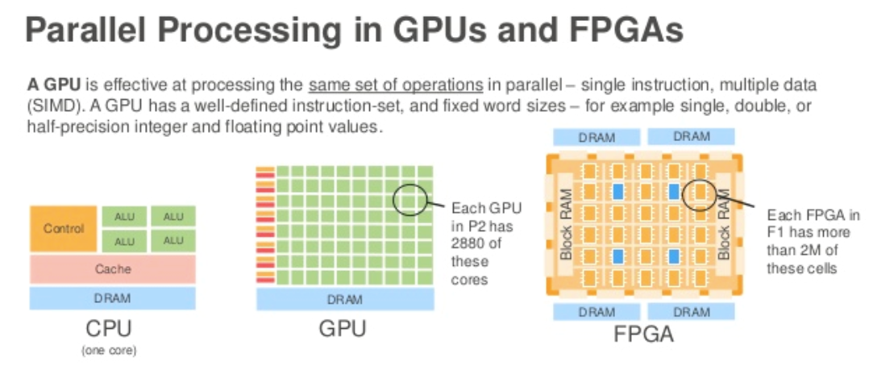
Power consumption CPU > GPU > FPGA
Central processing unit
single data
single instruction
Graphical processing unit
multiple data
single instruction
Field programmable gate array
multiple data
custom instructions
*Cryptomining
(Dangi, et al., 2019)
(Nguyen, et al., CCPR, 2021)
Notes:
https://nxtgen.com/World-of-CPU-GPU-&-FPGA-Simplified
World of CPU GPU & FPGA, Simplified!
Rajesh Dangi / October 29th, 2019
FPGA-based HPC accelerators: An evaluation on performance and energy efficiency
Tan Nguyen,Colin MacLean,Marco Siracusa,Douglas Doerfler,Nicholas J. Wright,Samuel Williams
First published: 22 August 2021
https://doi.org/10.1002/cpe.6570

Slide 16
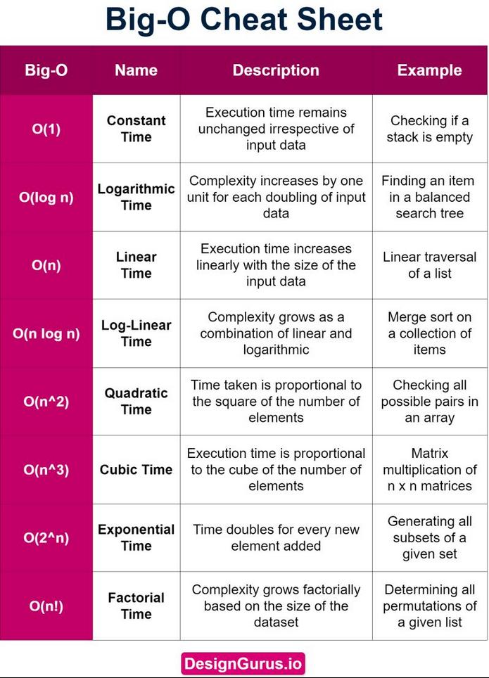
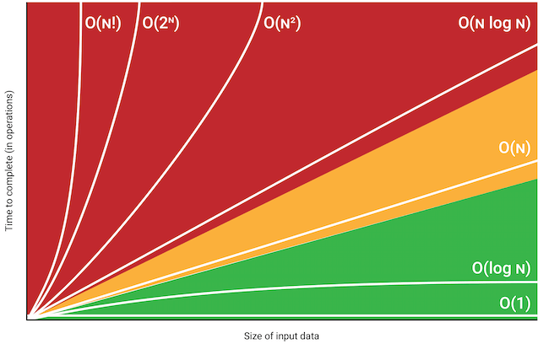
Algorithmic efficiency
Big-O notation:
“runtime is bounded by up to a constant by”
Notes:
Figure from: https://danielmiessler.com/blog/big-o-notation

Slide 17
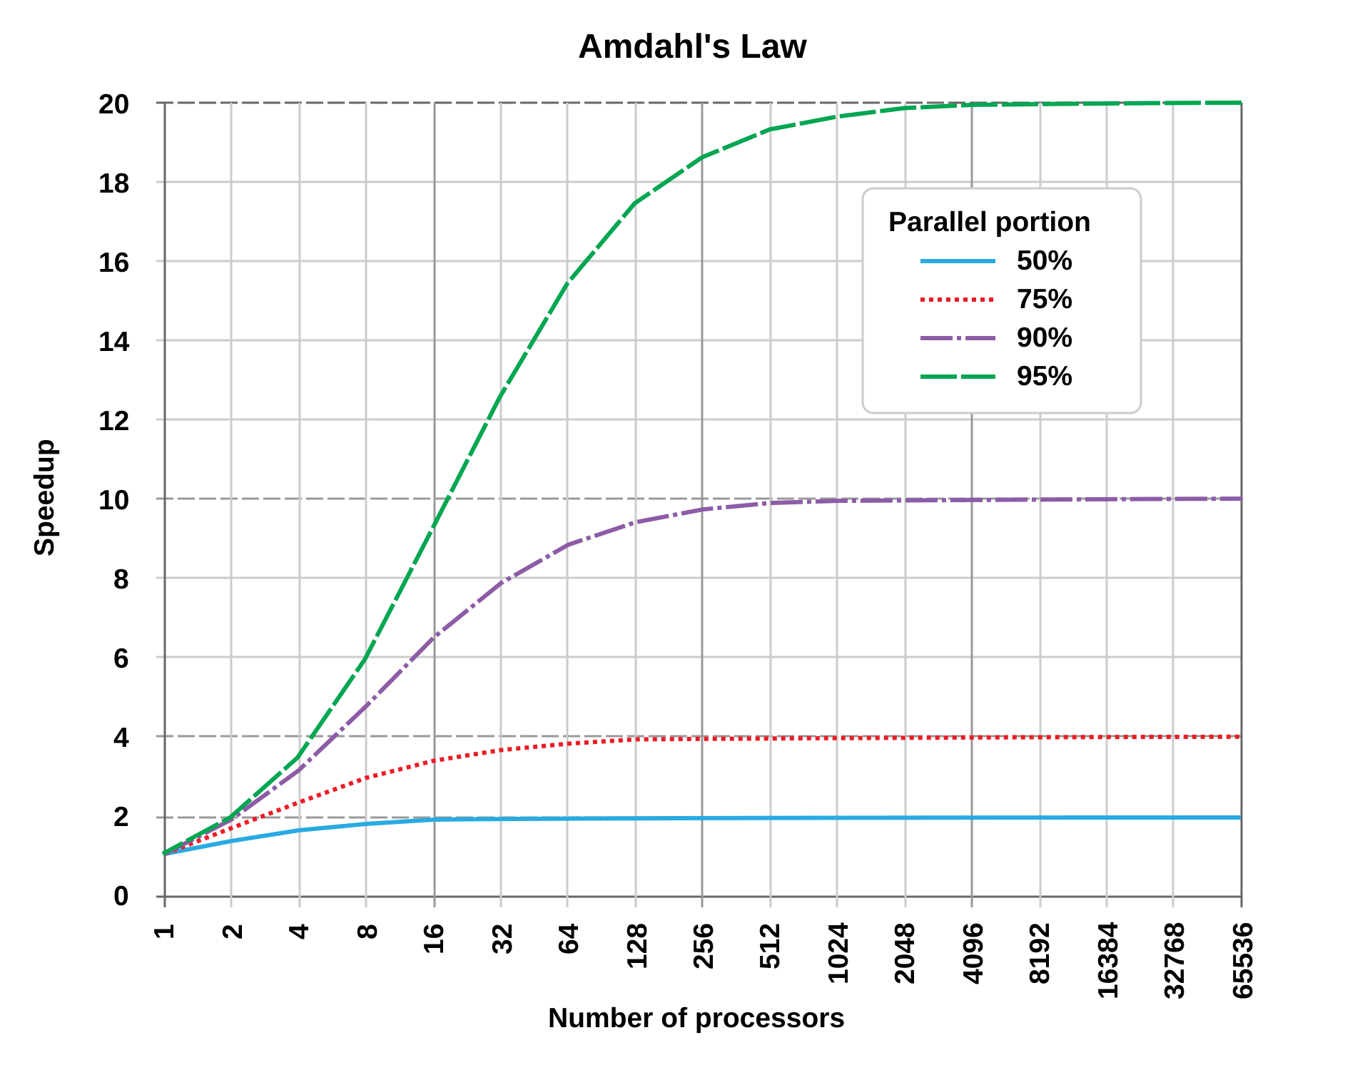
Amdalh’s law
Old runtime
Speed-up =
New runtime
Speeding up the slowest
Stage will have the largest
effect
Similar to “first order”
kinetics in enzymology

Slide 18
If we have unlimited compute, do we need to still worry about algorithmic efficiency?
Compute
Efficiency
Results
Operation
Time
Result
Operation
Result
Time
X
=
As compute capacity increases
Increasing algorithmic efficiency will have a larger effect

Slide 19
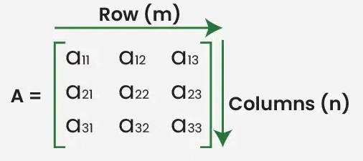
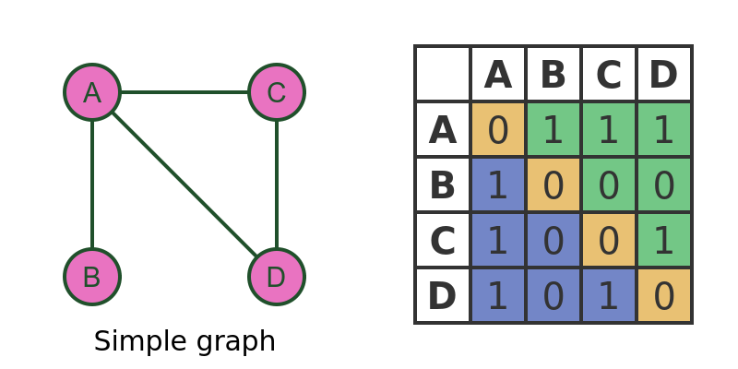
Matrix math
Very robust libraries
C/C++: Blas, eigen, lapack, armadillo
Python: numpy
R: Matrix
GPU: Pytorch, JAX
Building blocks for ML/data-science algorithms
Parallelizable on hardware
Foundational for deep learning
Properties
Dimension
Symmetry
Rank / Eigen Spectrum
Matrix <-> Graph
Creation / IO:
Ones, zeros, eye, linspace
Restructure:
Transpose
Reshape
Broadcasting
Newaxis
Operations:
Element-wise
dimension-wise
Interactions:
Vector matrix product
Inner / outer product
Matrix multiplication

Slide 20
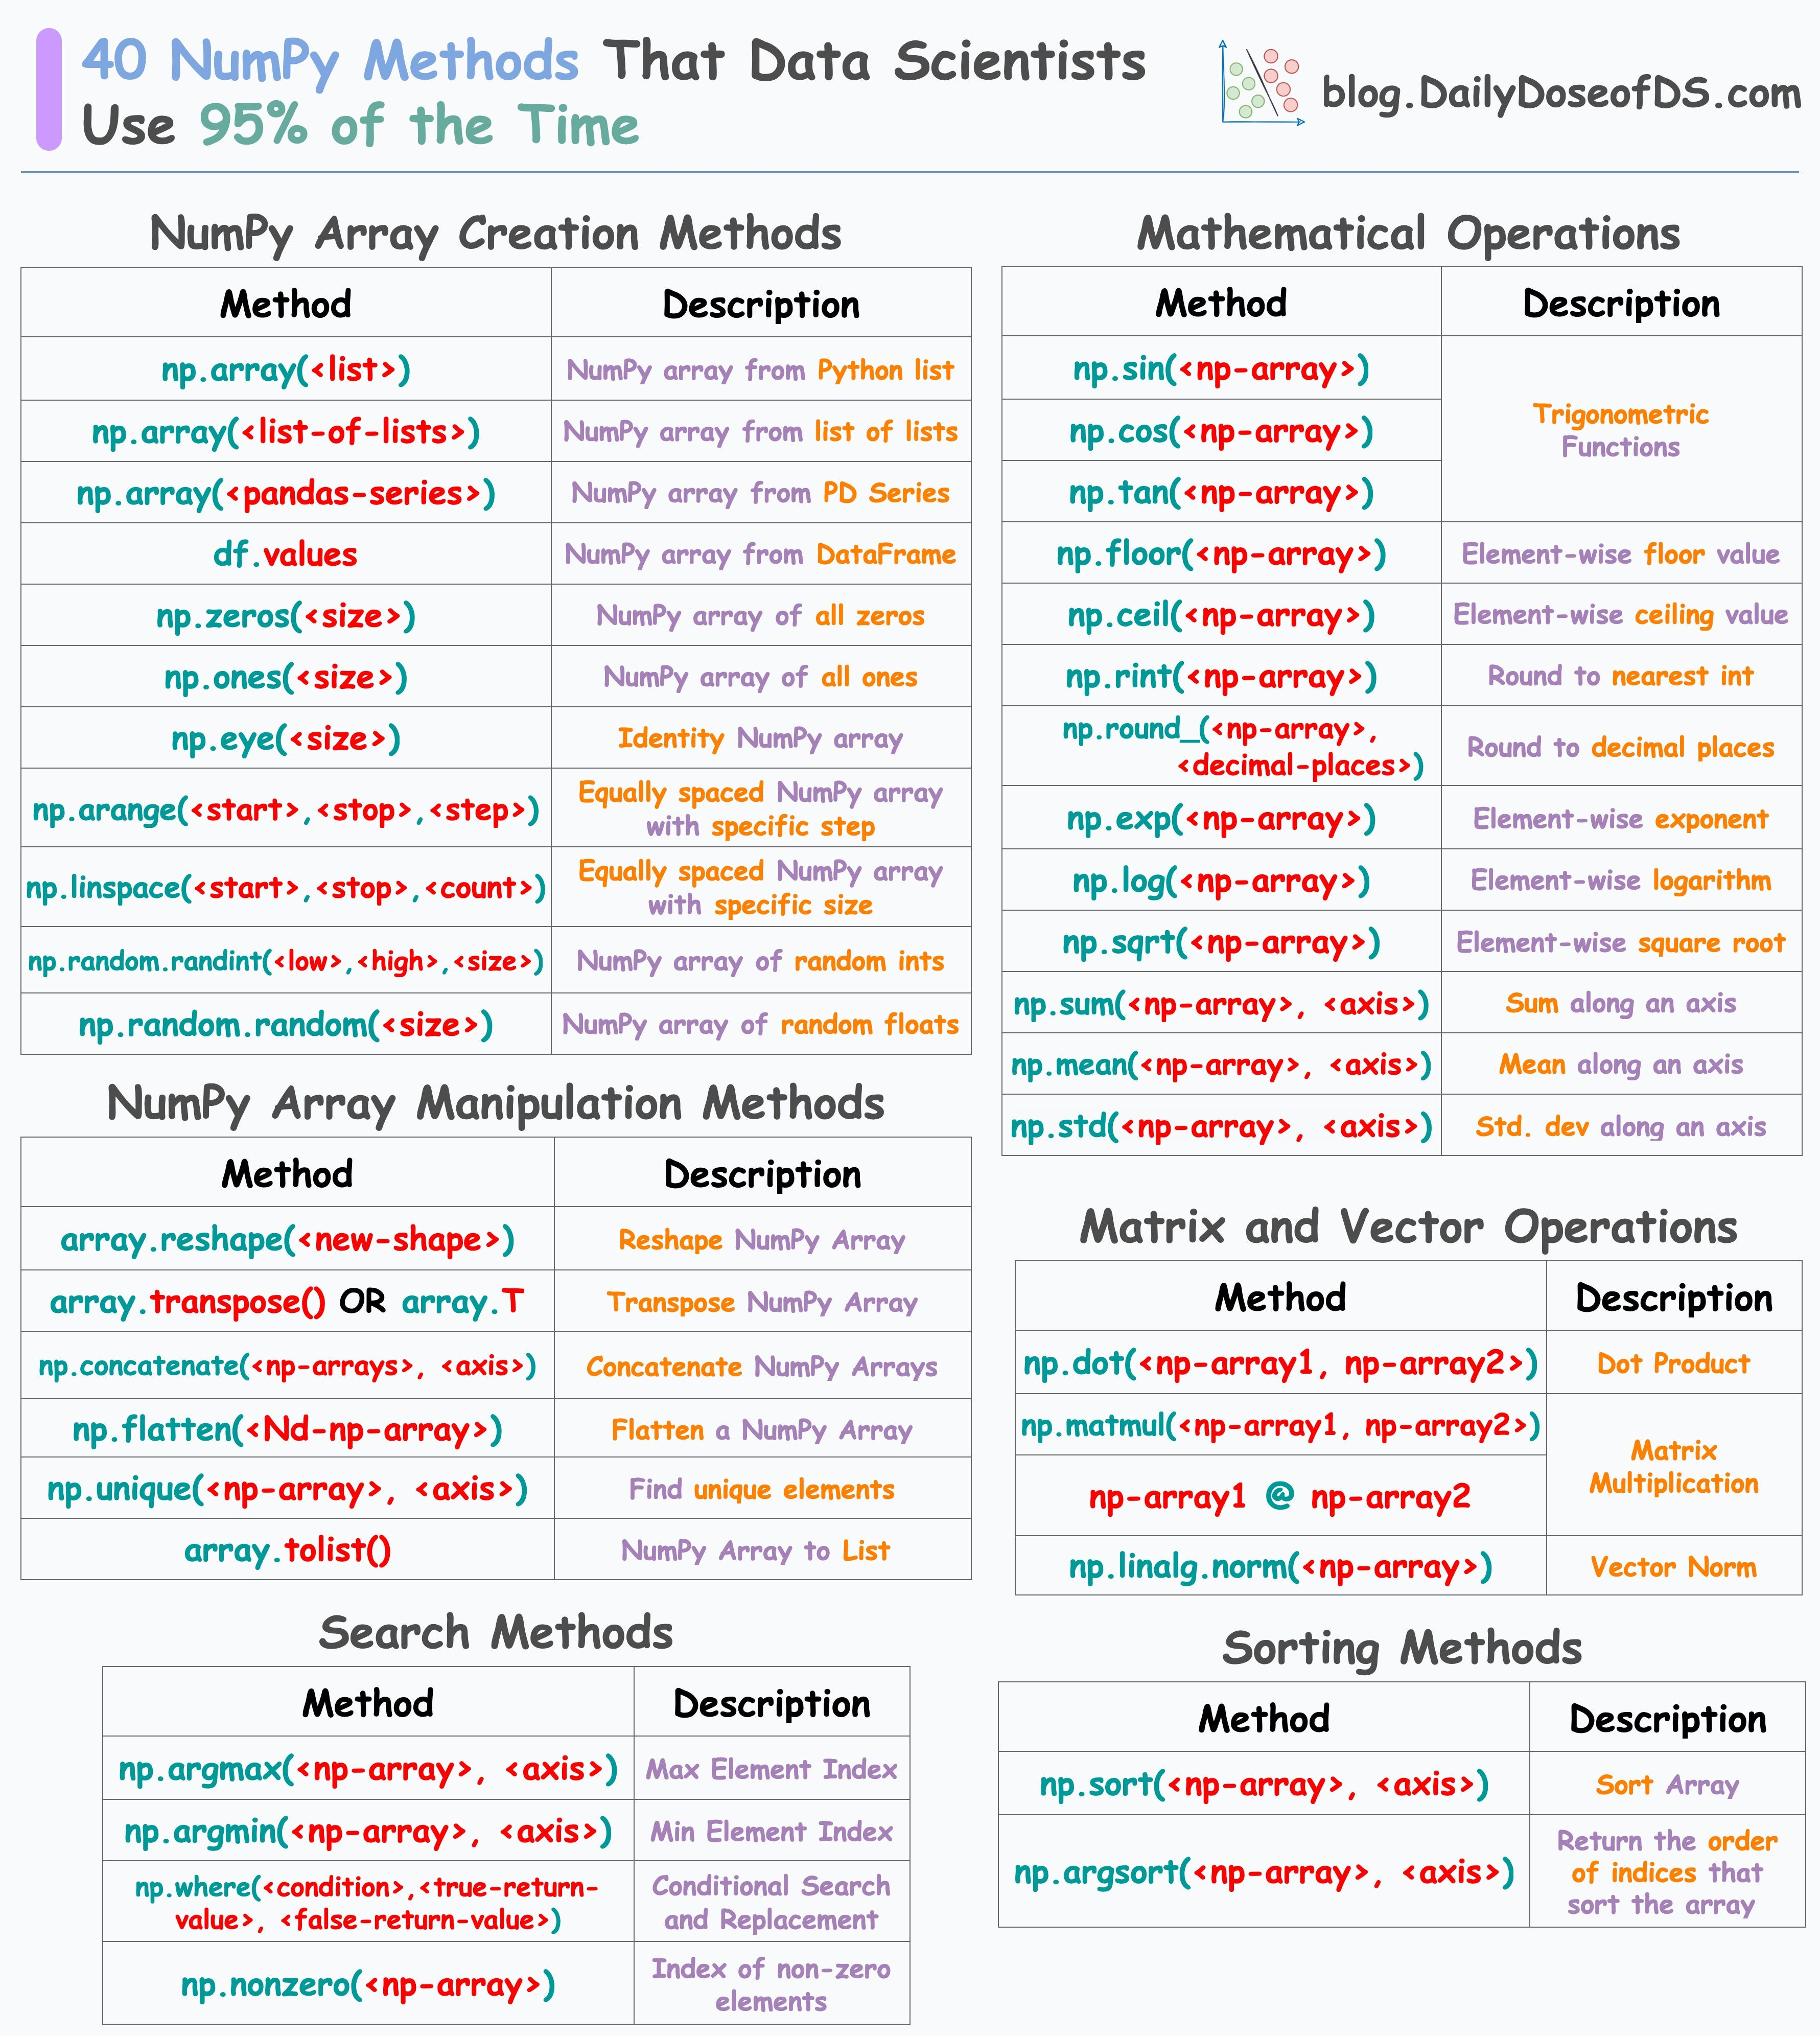
Matrix math numpy syntax
dailydoseofds.com
Notes:
https://blog.dailydoseofds.com/p/a-comprehensive-numpy-cheat-sheet

Slide 21
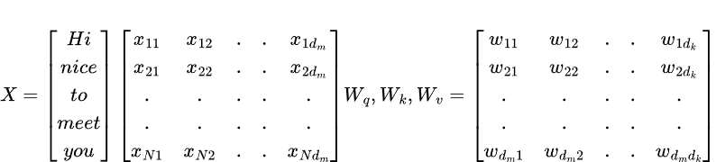

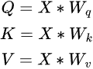
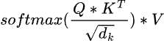
Example: Transformer
Def attention(x, Wq, Wk, Wv):
query = np.matmul(X,Wq)
key = np.matmul(X,Wk)
value = np.matmul(X,Wv)
# Calculate the dot product between the query and key vectors. dot_product = np.matmul(query, key.T) # Scale the dot product by the square root of the query dimension. scaled_dot_product = dot_product / np.sqrt(query.shape[-1]) # Calculate the attention weights. attention_weights = np.softmax(scaled_dot_product, axis=-1) # Calculate the output vectors. return np.matmul(attention_weights, value)
(Vaswani, 2017)
Notes:
Attention Is All You Need
Ashish Vaswani, Noam Shazeer, Niki Parmar, Jakob Uszkoreit, Llion Jones, Aidan N. Gomez, Lukasz Kaiser, Illia Polosukhin
https://arxiv.org/abs/1706.03762, 2017

Slide 22
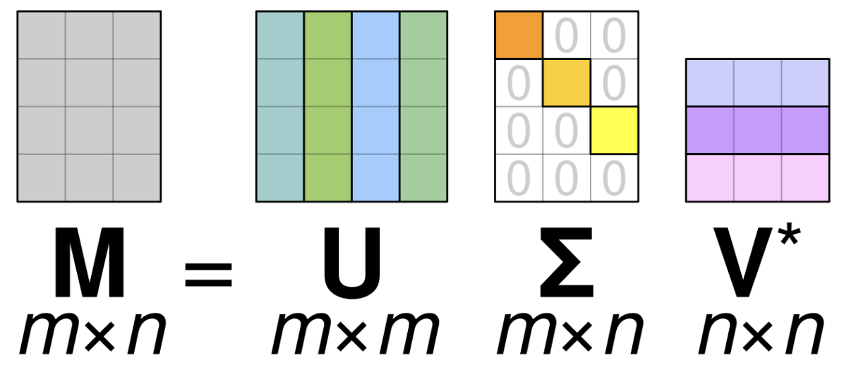
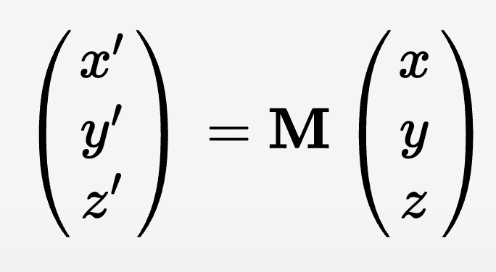
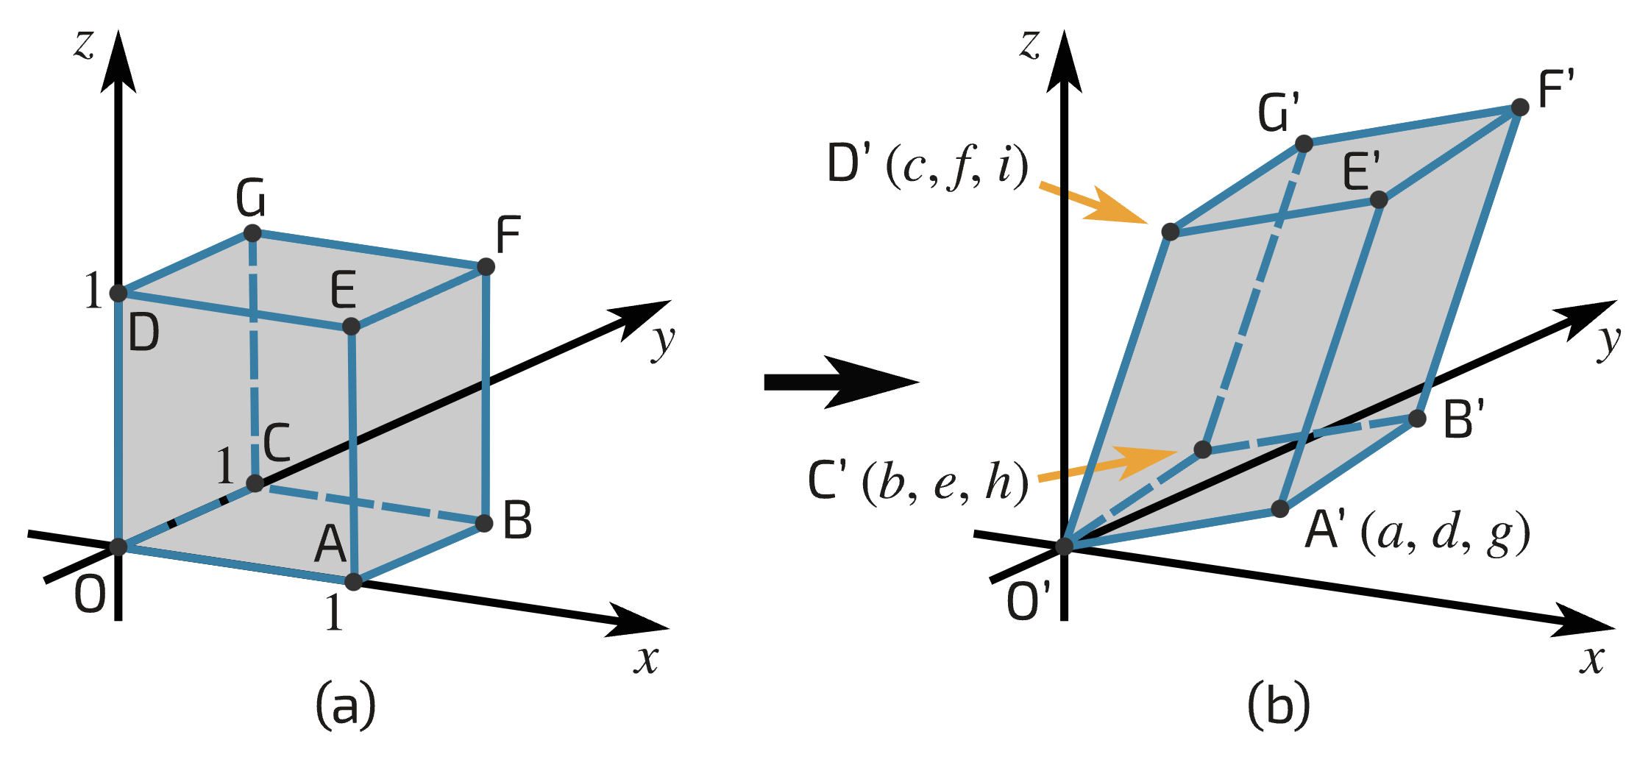
Spectrum of a matrix
Singular Value Decomposition
Matrices as
Linear
Operators
Rotate/flip -> stretch/shrink -> rotate/flip
The diagonal elements of Σ are the spectrum
The largest k of them are the “principal components”
The number of non-zero is the rank
Invertible if and only if dimension = rank
Computational complexity of SVD?
isaacphysics.org/
Notes:
https://isaacphysics.org/concepts/matrices_linear_transformations3d
Answer n*m*min(m,m)

Slide 23
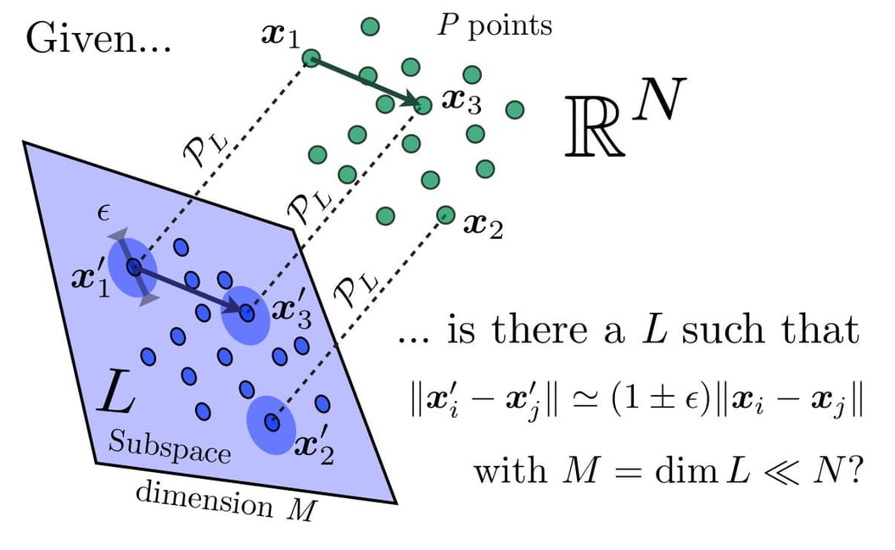
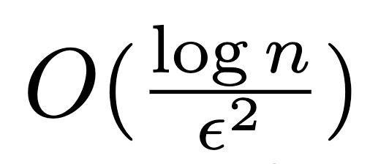
Johnson-Lindenstrauss Lemma
Random projections:
With large probability
pairwise distances are only distorted by at most 1 +/- ε
www.cantorsparadise.org/
Notes:
https://www.cantorsparadise.org/the-johnson-lindenstrauss-lemma-3058a123c6c/

Slide 24
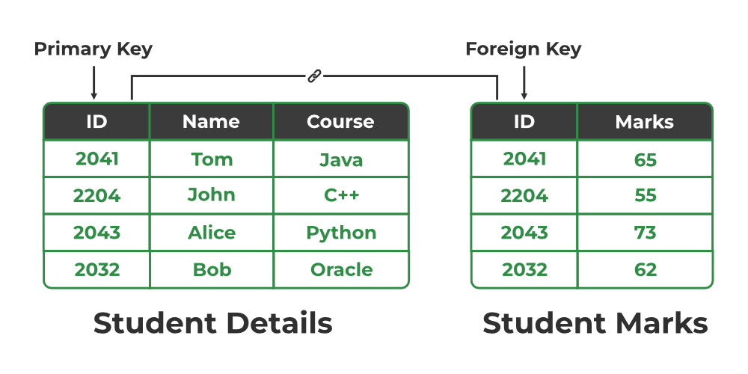
Database Management system
Examples: Sqlite3, MySQL, PostgreSQL
Each table has key columns, and value columns
Data is stored rowwise
Link tables together through foreign keys
Query tables using structured query language
SELECT
details.name,
marks.marks
FROM
details,
marks
WHERE marks.ID = details.ID
https://www.geeksforgeeks.org/
Notes:
https://www.geeksforgeeks.org/types-of-keys-in-relational-model-candidate-super-primary-alternate-and-foreign

Slide 25
On-disk File formats for data
.csv/.tsv
Prefer tsv many data contain commas and need to be quoted
.json/.yaml
Good for “dictionary/list” like data
Many good reader/writers
.parquet
Robust compressed column-oriented format
supported by Apache Arrow
.sqlite3
Robust single-file
Can be queried using SQL

Slide 26
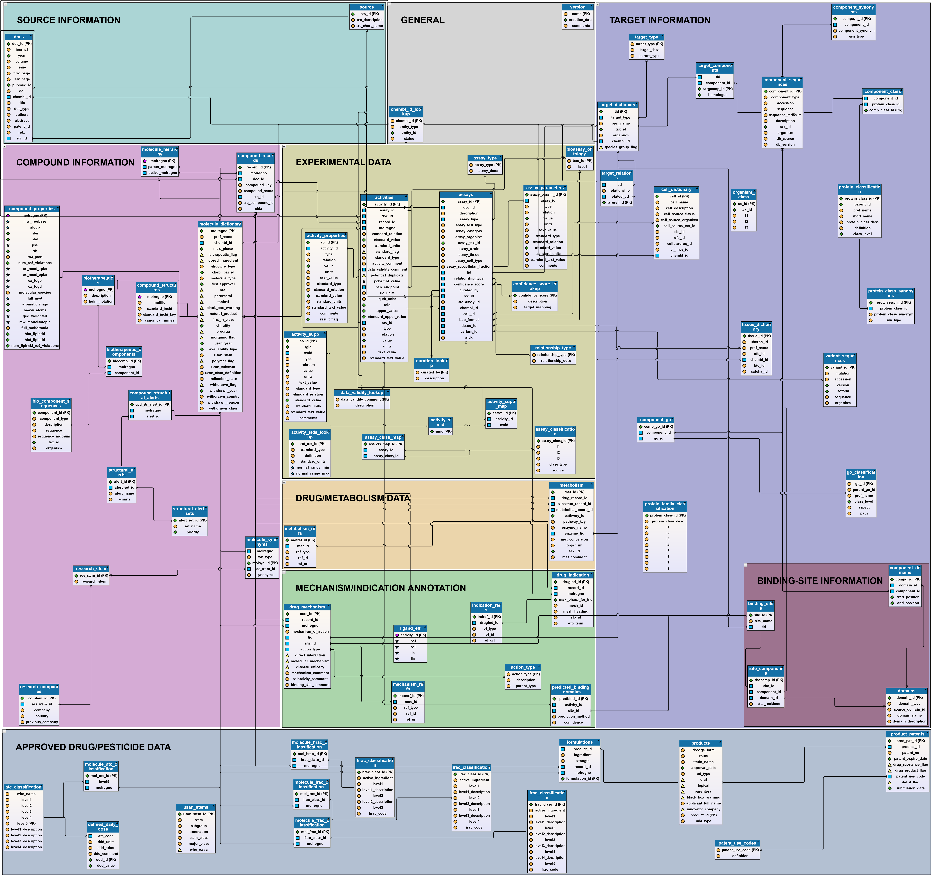
Database design
Keys
Primary key (unique, non-null)
composite, sequential
Table normalization
More tables => less redundancy
Less tables => easier to query
Index
Pre-compute for a table
Enables O(1) lookup of key
Faster joins
Views
Aliases for joins => virtual tables
Resource management
Allocation
Caching
Single/multiple threaded
Migration

Slide 27
Schema for
ChEMBL

Slide 28
Structure of data for SAR qSAR analysis
Reference
Reference ID
Year
Lab/Institution
TODO
Receptor
Receptor ID
Gene Name
Uniprot Entry
Species
Mutations
PDB ID
Reference
Substance
Substance ID
Alternate IDs
Source
SMILES
InChi
Depiction
Activity
Activity ID
Reference ID
Substance ID
Receptor ID
Formula for getting molecule depiction in cell where column D has the SMILES in it
=IMAGE(CONCATENATE(
"http://zinc15.docking.org/apps/mol/draw.png?smiles=", ENCODEURL(D2)))
Recommendations
Use google sheets (easy to share)
Upgrade to full DBMS as project if needed
Curation is a work in progress
Go after most important data first
Add additional tables as needed
Add version tag if saved/shared else

Slide 29
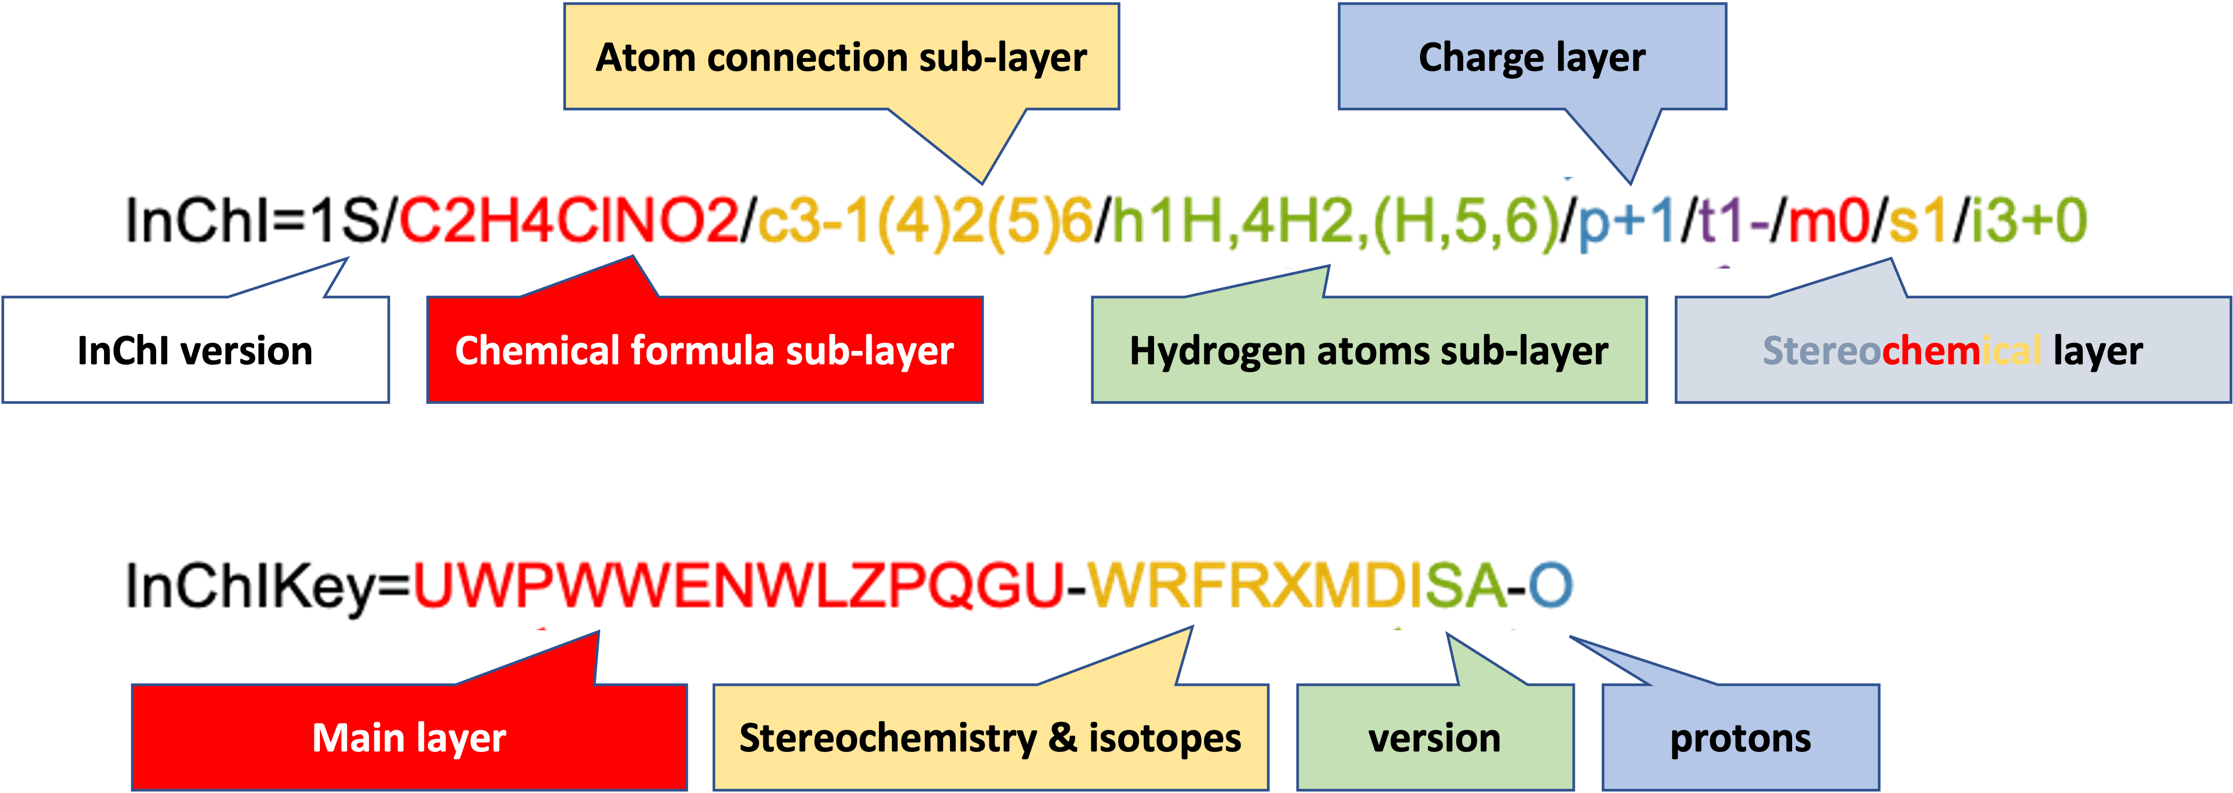
Chemoinformatic Identifiers
SMILES
Very widely used
Incompatible from different programs
Often a source of data science pain
InChi
Sponsored by IUPAC in 2005
Robust and now well supported
Layers
Chemical formula
Charge
Stereochemistry
Isotope
Hydrogens
Metal/organic/framework
SDF/mol2/pdb
3D coordinates of atoms
Standard, but some issues with atom typing
CCOC(=O)Nc1ccc(NCc2ccc(F)cc2)cc1N
https://www.inchi-trust.org/
https://cactus.nci.nih.gov/

Slide 30



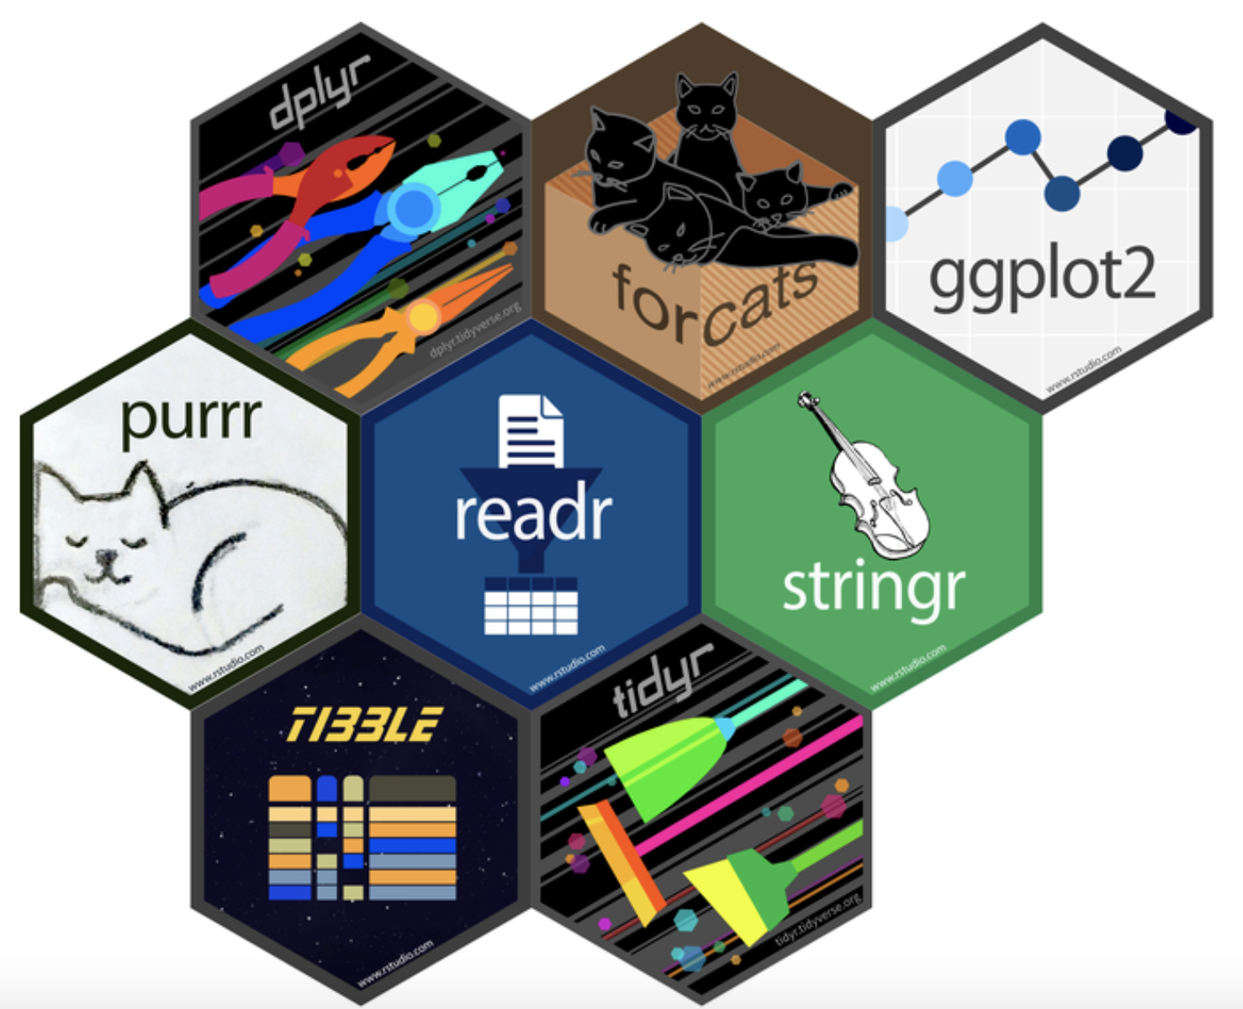
Tidyverse
New standard library for R
readr: reading and writing files
dplyr: working with tables of data
stringr: string manipulation
tidyr/purrr: data manipulation
ggplot2: plotting
forcats: discrete factor data
R Language idiosyncrasies
|> pipe operator
Non-standard evaluation

Slide 31
dplyr: A package for working with data.frames
glimpse: get list of columns and example values
select: select columns
filter: filter rows
mutate: create column from function of other values in row
join_{left,inner,full,semi,anti}: sql joins
bind_{rows,cols}: concatenate data.frames
arrange: sort data
distinct, count: filter or count distinct values of given columns
Can do queries over client/server databases too
In my opinion much better designed library than pandas
Faster and syntax is good once you get use to it

Slide 32
Pipe operator
first_arg |> f(second_arg) is the same as f(first_arg, second_arg)
Eliminates the need to define multiple intermediate objects
Allows piping the result from one function into the next to build "pipelines"
data |>
# filter to rows whose continent is Americas and the year 2018 dplyr::filter(continent == "Americas", year == "2018") |>
# shows the country and life expectancy value for these rows dplyr::select(country, life_exp)

Slide 33
stringr Regular Expressions
Example:
# find mis-formatted uniprot entries
data |> dplyr::filter( !(uniprot_entry |> stringr::detect( "^[A-Z0-9]{1,10}_[A-Z0-9]{1,5}$"))
Use online regular expression testers
Create your own character class using []:
[abc] - match a, b, or c
[a-z] - match every character between a and z
[^abc] - match anything except a, b, or c
[\^\-] - match ^ or -
Anchors:
^ - match beginning
$ - match end
Repeat previous
* - match 0 or more
+ - match 1 or more
{2} - match exactly 2
{2, } - 2 or more
{2,4} - between 2 and 4

Slide 34
Pivot data to long format
Tidy data
Each column is a variable
each row is an observation
each cell is a measurement
id | name | value
1 | a | 2
1 | b | 8
1 | c | 5
2 | a | 5
2 | b | 3
2 | c | 4
3 | a | 7
3 | b | 1
3 | c | 7
pivot_longer
id | a | b | c
1 | 2 | 8 | 5
2 | 5 | 3 | 4
3 | 7 | 1 | 7
pivot_wider
data_long <- data_wide |> tidyr::pivot_longer( cols = c(a, b, c), names_to = "name", values_to = "value")
data_wide <- data_long |> tidyr::pivot_wider( id_cols = id, names_from = name, values_from = value)

Slide 35
Split-apply-combine
group_by/ungroup: define groups by unique elements in given columns
summarize: summarize each group into a single column
do: apply function over
data |> dplyr::group_by(continent, year) |> dplyr::summarize(
mean_life_exp = mean(life_exp), total_gdp = sum(gdp),
.groups = “drop”)
data |> dplyr::group_by(continent, year) |> dplyr::do({
grouped_data <- . # give the grouped data a name
grouped_data |>
dplyr::left_join(drug_prices, by = c(“continent”, “year”)
}) |>
dplyr::ungroup()

Slide 36
Non-Standard Evaluation good for fast coding tricking for programming
Names treated as string literals
data |> dplyr::select(col1) instead of data |> dplyr::select("col1")
A little confusing at first, but more efficient
Super confusing to try use in writing functions
Use "handlbars" {{ }} for NSE input → NSE value
get_column <- function(data, column){ data |> dplyr::select({{column}}) }
use "walrus assignment" := for NSE input → NSE name
rename_column <- function(data, old, new){data |> dplyr::rename({{new}} := {{old}})} data.frame(a = c(1,2,3)) |> rename_column(a, b) |> dplyr::glimpse() Rows: 3 Columns: 1 $ b <dbl> 1, 2, 3

Slide 37
Non-Standard Evaluation Cheat Sheet
Use Case | Function | Usage | Result
unquote to avoid NSE name collision | condition <- function(df, x) { df |> dplyr::filter(x == !!x)} | df |> condition(3) | x y 1 3 6
NSE to NSE (one argument) | my_select <- function(df, col) { df |> dplyr::select({{col}})} | df |> my_select(x) | x 1 1 2 2 3 3
NSE to NSE (multiple arguments) | my_select <- function(df, cols) { df |> dplyr::select(!!!cols)} | df <- data.frame( xx=c(1,2,3), yy=c(4,5,6)) df |> my_select(vars(xx, yy)) | xx yy 1 1 4 2 2 5 3 3 6
string to NSE | col_mean <- function(df, col_name) { df |> dplyr::summarize( col_mean=mean(!!sym(col_name)))} | df |> col_mean(col_name) | col_mean 1 2
NSE to string | first_value <- function(df, col) { df[1, deparse(substitute(col))]} | df |> first_value(x) | [1] 1
NSE to formula | my_lm <- function(df, y, x) { lm( formula = rlang::new_formula( lhs = rlang::ensym(y), rhs = rlang::ensym(x)), data = df)} | df <- data.frame( xx=c(1,2,3), yy=c(4,5,6)) df |> my_lm(yy, xx)
Using tidyselect in functions see dplyr:::select.data.frame | my_complex_select <- function(df, x_cols, y_cols) { x_cols <- x_cols |> expr() |> tidyselect::eval_select(df) y_cols <- y_cols |> expr() |> tidyselect::eval_select(df) # x_cols and y_cols are now named vectors of # column indices into df ... } | df <- data.frame( x1 = c(1,2,3), x2 = c(3,3,4), y1 = c(3,3,3)) df |> my_complex_select( x_cols = c(x1, x2), y_cols = y1)
df <- tibble::tibble(
x=c(1,2,3),
y=c(4,5,6))
x <- 3
col_name <- "x"
Programming with dplyr
Advanced R: Non-standard evaluation

Slide 38
R vs Python
R advantages
Interactive data exploration (tidyverse)
Strong for statistical analysis
Package management system
Interface with c++
R Weakness
Hard to write “software”
non-standard evaluation
Weak typing
Confusing class/module systems
Python advantages
Easy to write “software”
Strong for ML / Deep Learning
Lots of tutorials / users
Python Weakness
Difficult to write performant code
Hard to interface with C++
Weak typing / data management
Hard to write parallel code
Package management
PIP/Conda is a mess
Consider trying UV

Slide 39
R/Tidyverse References
https://www.rebeccabarter.com/tutorials/
https://r4ds.had.co.nz/wrangle-intro.html
https://www.tidyverse.org/
https://www.rstudio.com/resources/cheatsheets/
https://win-vector.com/2019/04/02/standard-evaluation-versus-non-standard-evaluation-in-r/
http://adv-r.had.co.nz/Computing-on-the-language.html

